Slide 1
Computer Science Parallel and Distributed Computation Message Passing Interface (MPI)
Kun Suo
Computer Science, Kennesaw State University
https://kevinsuo.github.io/

Slide 2
Review
MPI introduction
Helloworld of MPI
Performance evaluation
Example: how to solve problems in MPI
Trapezoidal problem

Slide 3
Outline
MPI_Send/MPI_Receive
MPI_Reduce/MPI_Allreduce
MPI_Broadcast
MPI_Scatter
MPI_Gather

Slide 4
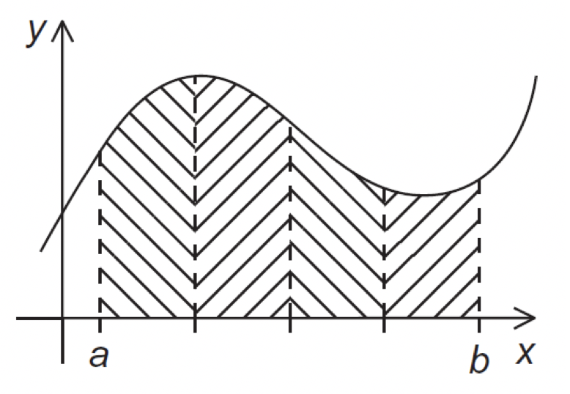

Communication
I send
I send
Rank = 1
Rank = 2
Rank = n
I receive
Rank = 0

Slide 5
Point-to-Point communication
I send
Rank = 1
Rank = 2
…
Rank = 7
I receive
Rank = 0
How many send/receive and add operation?
7 sends and 7 receives
7 adds

Slide 6
Point-to-Point communication
I send
Rank = 1
Rank = 2
…
Rank = 7
I receive
Rank = 0
How many send/receive and add operation on master node (Rank = 0)?
7 sends and 7 receives
7 adds

Slide 7
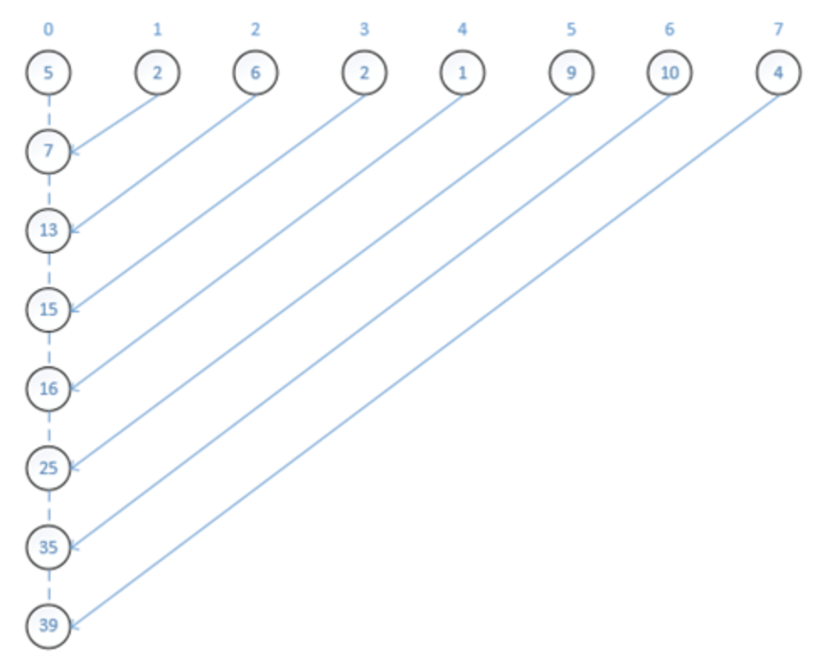
Point-to-Point communication
How many send/receive and add operation on master node (Rank = 0)?
7 sends and 7 receives
7 adds

Slide 8




Tree-structured communication
In the first phase:
(a) Process 1 sends to 0; 3 sends to 2; 5 sends to 4; and 7 sends to 6.
(b) Processes 0, 2, 4, and 6 add in the received values.
(c) Processes 2 and 6 send their new values to processes 0 and 4, respectively.
(d) Processes 0 and 4 add the received values into their new values.

Slide 9
Tree-structured communication
In the first phase:
(a) Process 1 sends to 0; 3 sends to 2; 5 sends to 4; and 7 sends to 6.
(b) Processes 0, 2, 4, and 6 add in the received values.
(c) Processes 2 and 6 send their new values to processes 0 and 4, respectively.
(d) Processes 0 and 4 add the received values into their new values.

Slide 10


Tree-structured communication
In the first phase:
(a) Process 1 sends to 0; 3 sends to 2; 5 sends to 4; and 7 sends to 6.
(b) Processes 0, 2, 4, and 6 add in the received values.
(c) Processes 2 and 6 send their new values to processes 0 and 4, respectively.
(d) Processes 0 and 4 add the received values into their new values.

Slide 11
Tree-structured communication
In the first phase:
(a) Process 1 sends to 0; 3 sends to 2; 5 sends to 4; and 7 sends to 6.
(b) Processes 0, 2, 4, and 6 add in the received values.
(c) Processes 2 and 6 send their new values to processes 0 and 4, respectively.
(d) Processes 0 and 4 add the received values into their new values.

Slide 12

Tree-structured communication
In the second phase:
(a) Process 4 sends its newest value to process 0.
(b) Process 0 adds the received value to its newest value.

Slide 13
Tree-structured communication
In the second phase:
(a) Process 4 sends its newest value to process 0.
(b) Process 0 adds the received value to its newest value.

Slide 14
Tree-structured communication
How many send/receive and add operation?
7 sends and 7 receives
7 adds

Slide 15
Tree-structured communication
How many send/receive and add operation on master node (Rank = 0)?
3 sends and 3 receives
3 adds

Slide 16
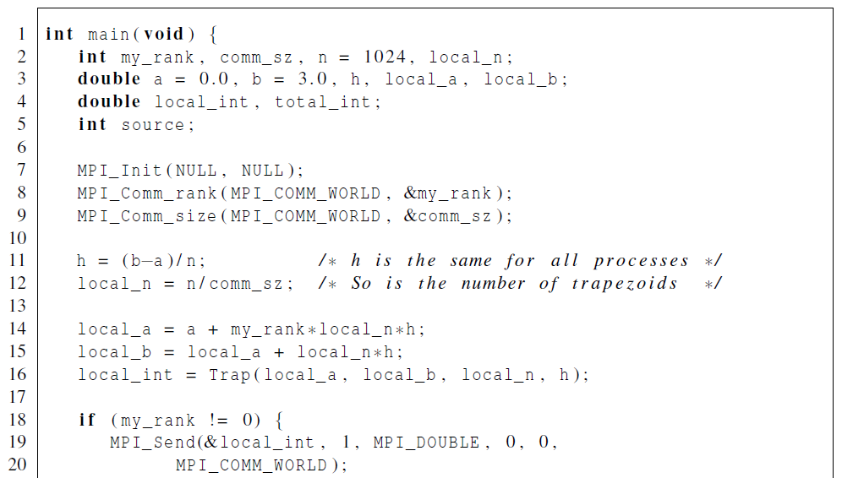
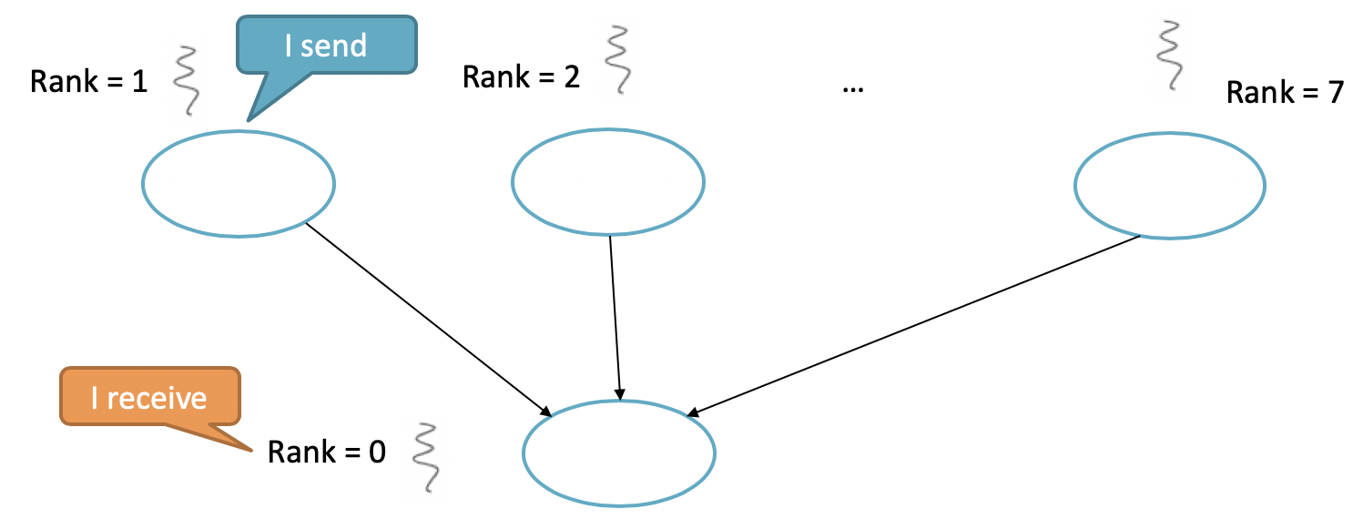
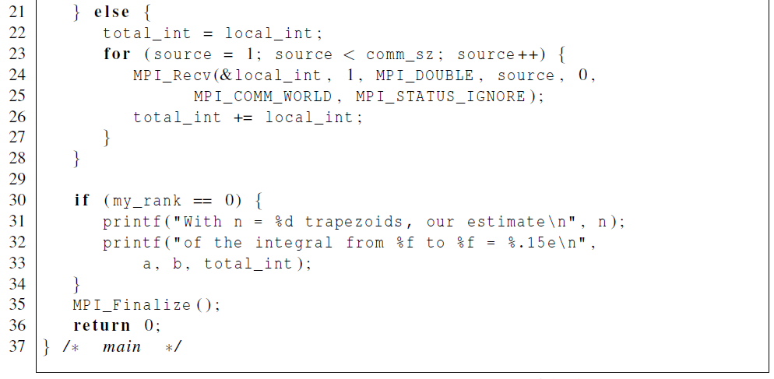
Point-to-Point communication code

Slide 17
Collective (tree-structure) communication code
MPI_Reduce(&local_int, &total_int,
1, MPI_DOUBLE,
MPI_SUM, 0, MPI_COMM_WORLD);

Slide 18
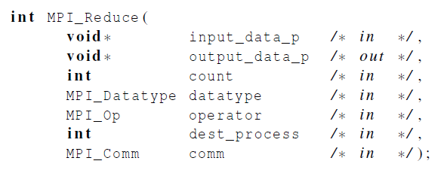
MPI_Reduce
input
output
Will do sum up for the inputs
Process 0 will do it

Slide 19
MPI_Reduce
input
output
Will do sum up for the inputs
Process 0 will do it

Slide 20
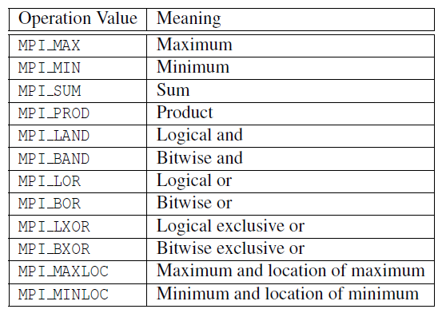
Besides Sumup, it can also do:

Slide 21
Besides Sumup, it can also do:
MPI_Reduce(&local_int, &total_int,
1, MPI_DOUBLE,
MPI_MAX, 0, MPI_COMM_WORLD);
MPI_Reduce(&local_int, &total_int,
1, MPI_DOUBLE,
MPI_MIN, 0, MPI_COMM_WORLD);
MPI_Reduce(&local_int, &total_int,
1, MPI_DOUBLE,
MPI_PROD, 0, MPI_COMM_WORLD);
Rank = 1
Rank = 2
…
Rank = 7
x1
x2
x7
MAX(x1, x2, …, x7)
MIN(x1, x2, …, x7)
x1 * x2 * … * x7

Slide 22
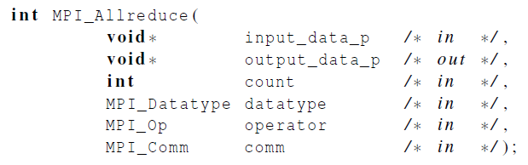
MPI_Allreduce
Useful in a situation in which all of the processes need the final result.
Sum up first and then distribute to everyone

Slide 23
A global sum followed by distribution of the result
Sum up
Distribution
9 is distributed to every process

Slide 24
What if I only need to distribute?
MPI_Reduce
MPI_Allreduce
?

Slide 25
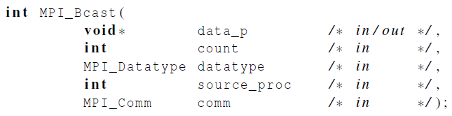
Broadcast
Data belonging to a single process is sent to all of the processes in the communicator.

Slide 26

A tree-structured broadcast

Slide 27
Example of MPI_Bcast
Rank = 0
{3,6,9}
MPI_Bcast
Rank = 1
Rank = 2
…
Rank = 7
{3,6,9}
{3,6,9}
{3,6,9}

Slide 28
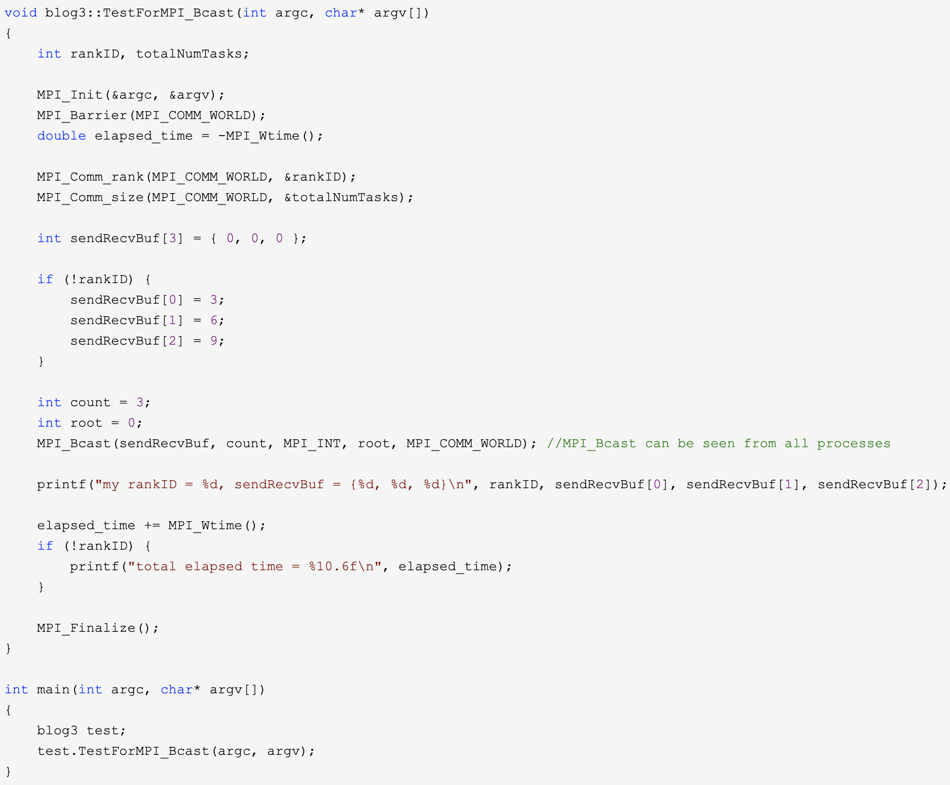
Example of MPI_Bcast

Slide 29
Example of MPI_Bcast
buffer is {0,0,0}
rankID = 0 will inits buffer as {3,6,9}
Print the received data

Slide 30
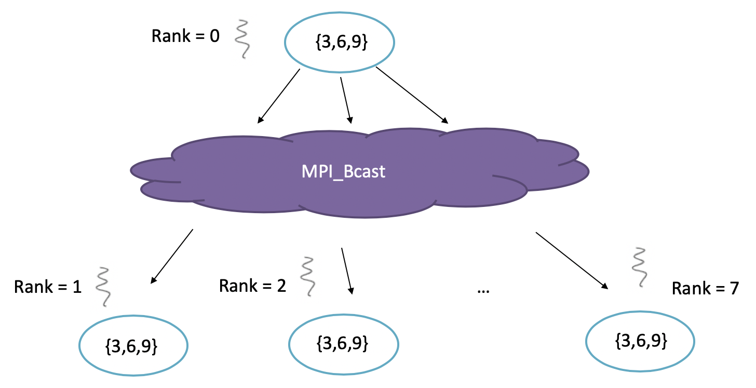
Example of MPI_Bcast

Slide 31
What if I only need to distribute?
MPI_Reduce
MPI_Allreduce
MPI_Bcast

Slide 32
Data distributions: vector addition

Slide 33
Partitioning options
Block partitioning
Assign blocks of consecutive components to each process.
Cyclic partitioning
Assign components in a round robin fashion.
Block-cyclic partitioning
Use a cyclic distribution of blocks of components.

Slide 34
Partitioning options
Block partitioning vs Cyclic partitioning

Slide 35
Partitioning options
Block partitioning vs Cyclic partitioning

Slide 36
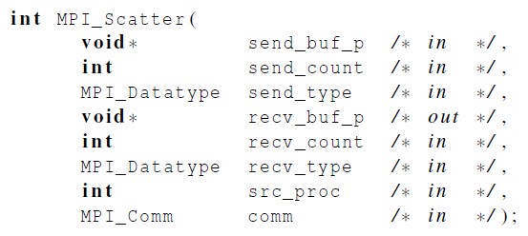
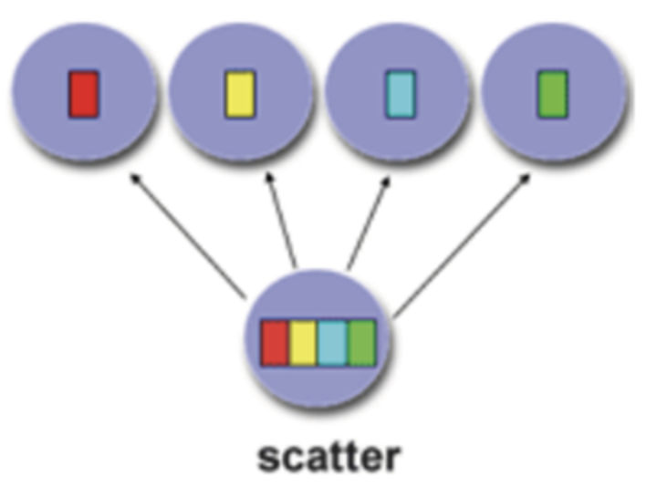
Scatter: partition & distribution
MPI_Scatter can be used in a function that reads in an entire vector on process 0 but only sends the needed components to each of the other processes.
sendCount, each process gets n data

Slide 37
Example of MPI_Scatter
1 | 2 | 3 | 4
5 | 6 | 7 | 8
9 | 10 | 11 | 12
13 | 14 | 15 | 16
Rank = 0
…
Rank = 1
Rank = 2
Rank = 7

Slide 38
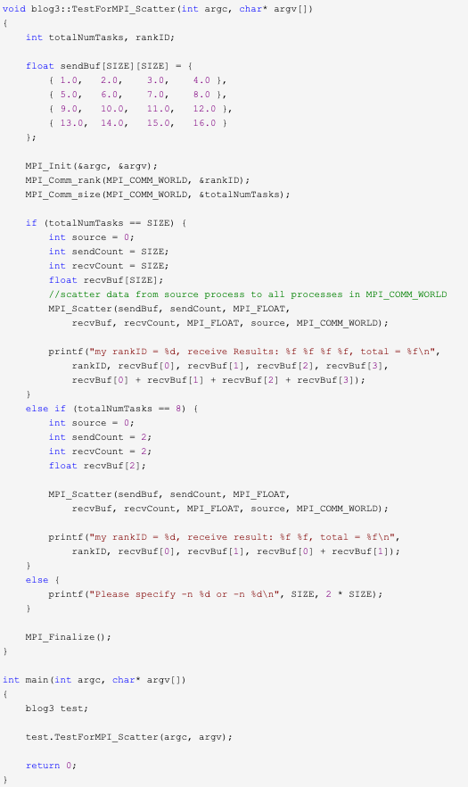
Example of MPI_Scatter
Size = 4
1 | 2 | 3 | 4
5 | 6 | 7 | 8
9 | 10 | 11 | 12
13 | 14 | 15 | 16

Slide 39
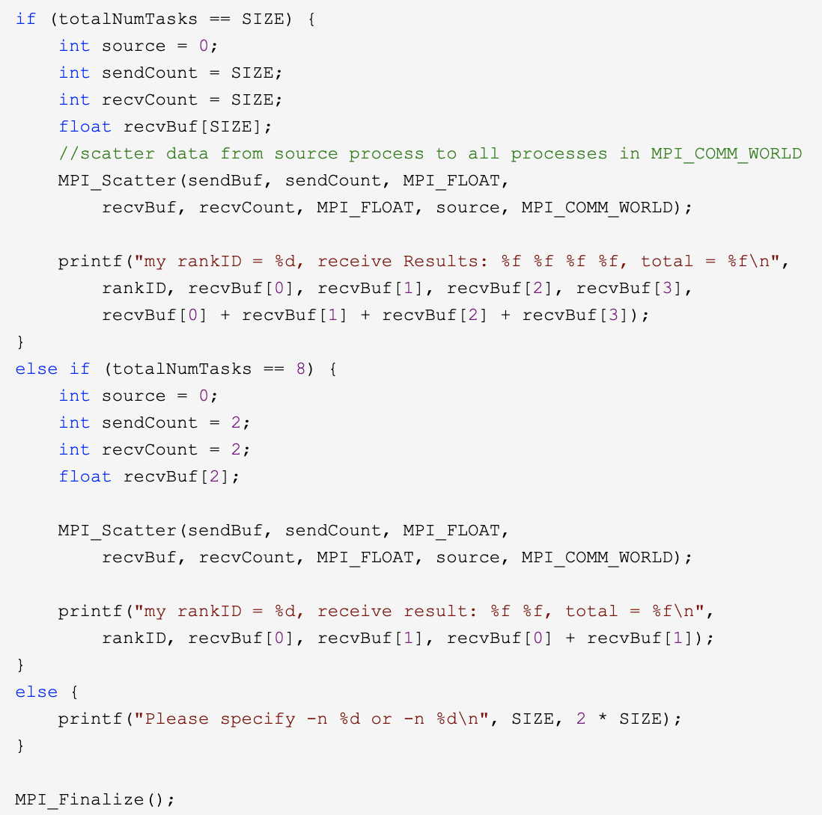


Example of MPI_Scatter
1 | 2 | 3 | 4
5 | 6 | 7 | 8
9 | 10 | 11 | 12
13 | 14 | 15 | 16
Size = 4
sendCount = 2, each process gets 2 data
After each process receives the data, sum them up

Slide 40
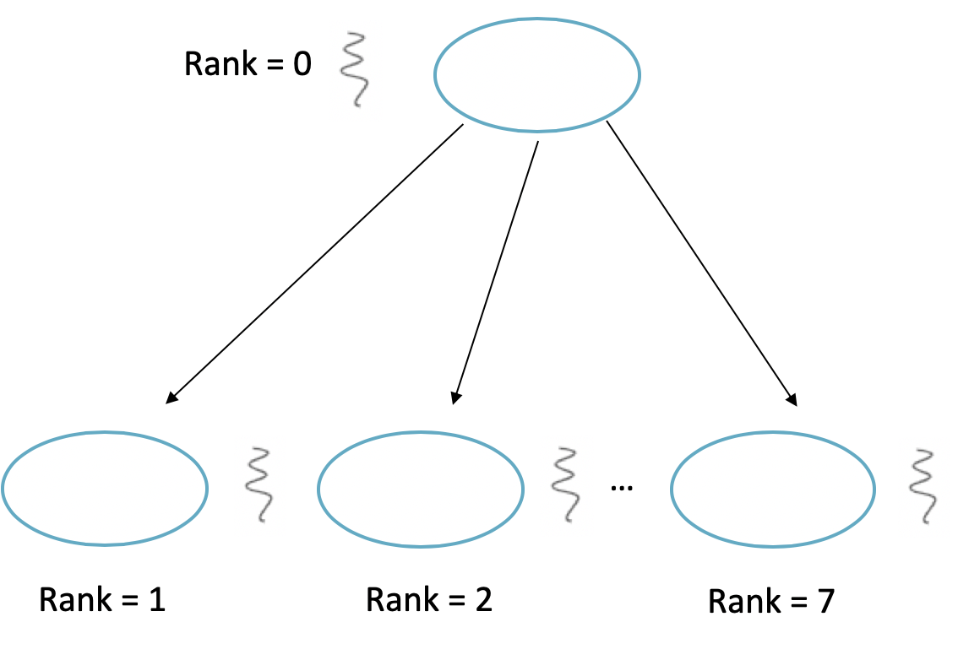
Example of MPI_Scatter
1 | 2 | 3 | 4
5 | 6 | 7 | 8
9 | 10 | 11 | 12
13 | 14 | 15 | 16

Slide 41
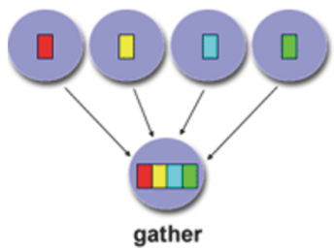
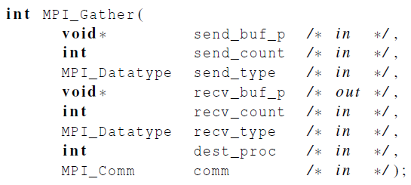
Gather
Collect all of the components of the vector onto process 0, and then process 0 can process all of the components.
Send data
Receiver ID

Slide 42
Example of MPI_Gather
Rank = 0
Each process sends its rankID to the array in process 0
…
Rank = 1
Rank = 2
Rank = 7

Slide 43
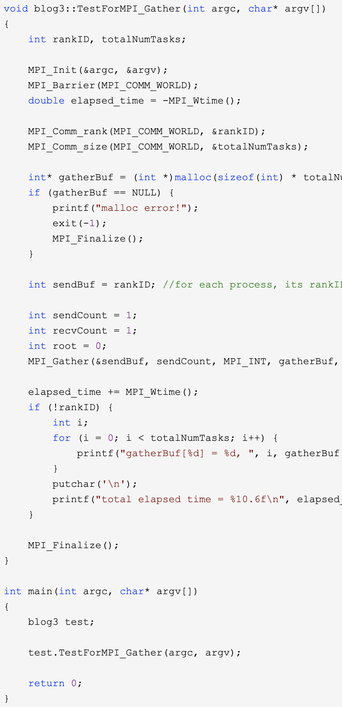
Example of MPI_Gather

Slide 44
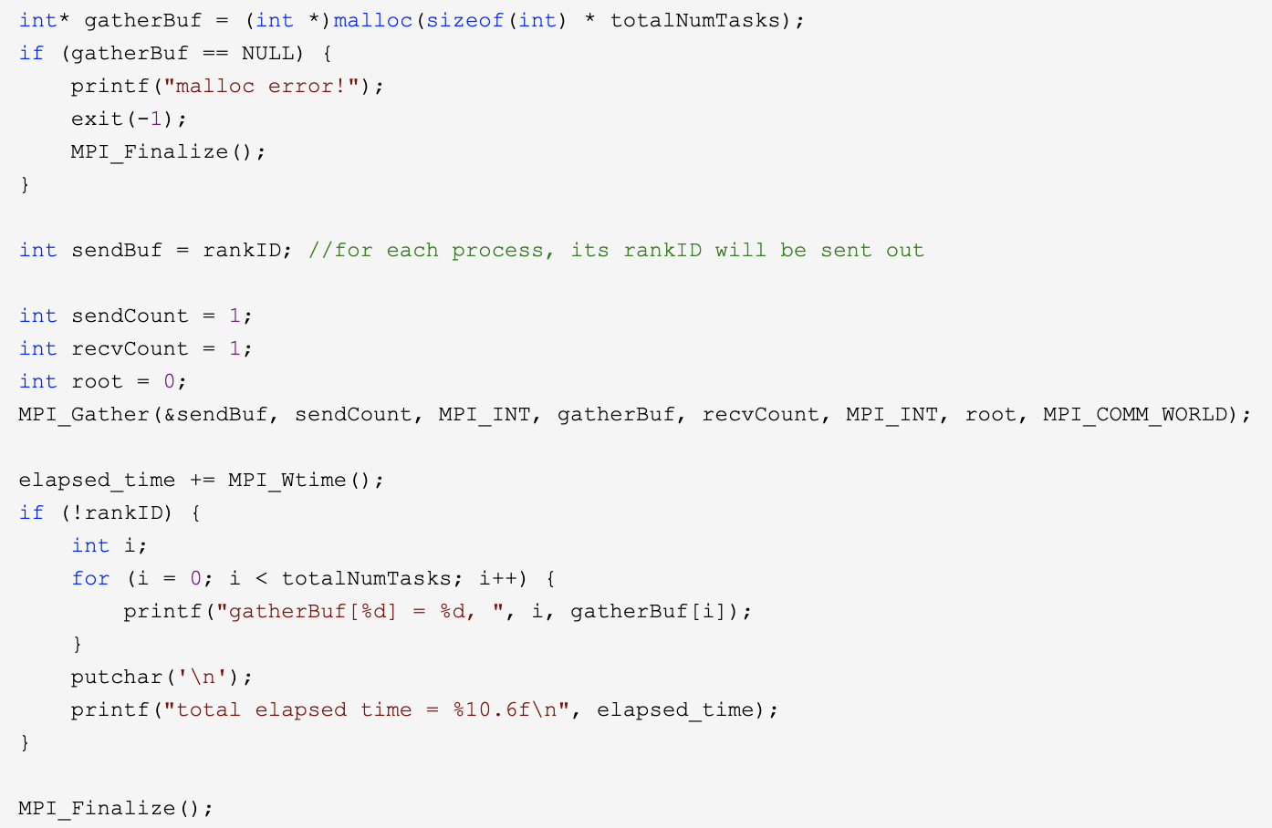
Example of MPI_Gather
The sent content is the rankID
The sent content is the rankID
Receiver is process 0
Data size is 1

Slide 45
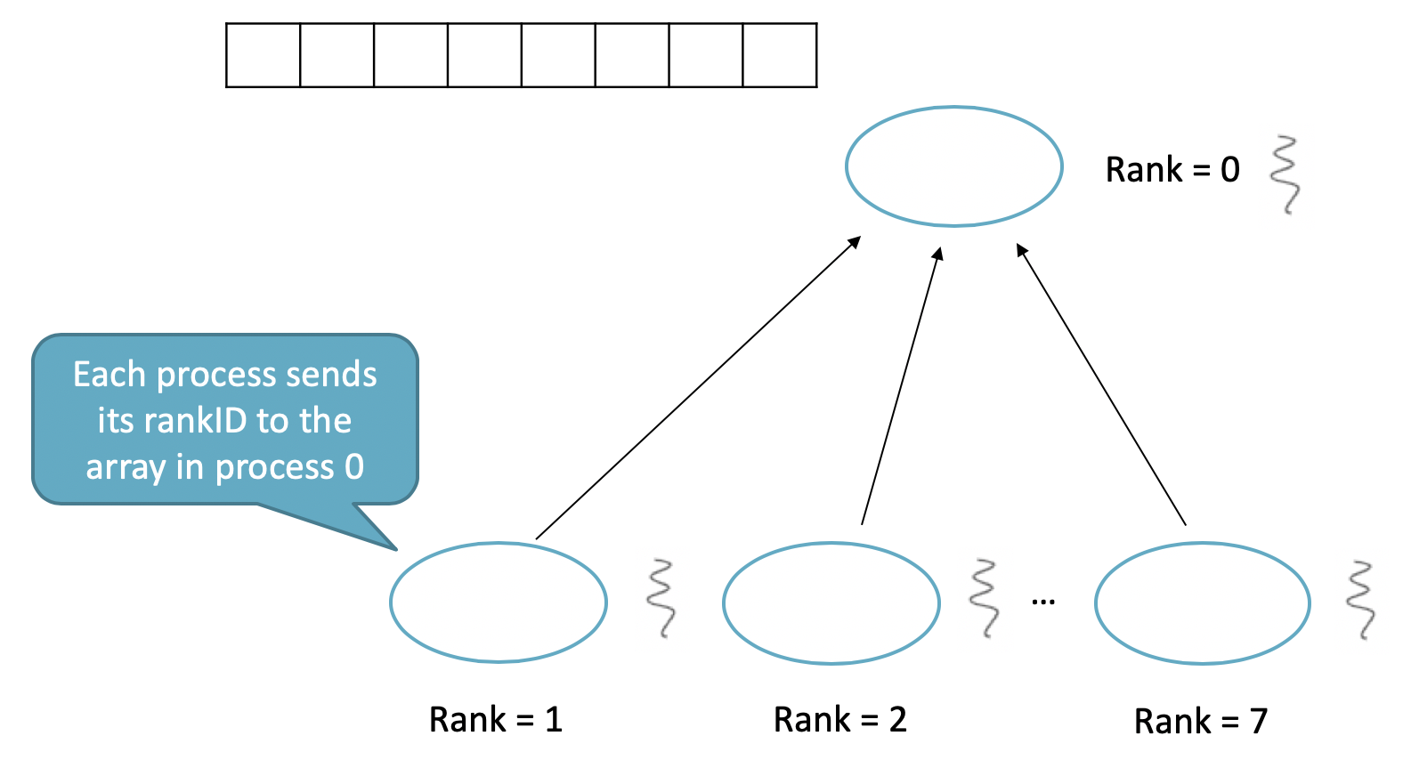
Example of MPI_Gather
0 | 1 | 2 | 3 | 4 | 5 | 6 | 7

Slide 46
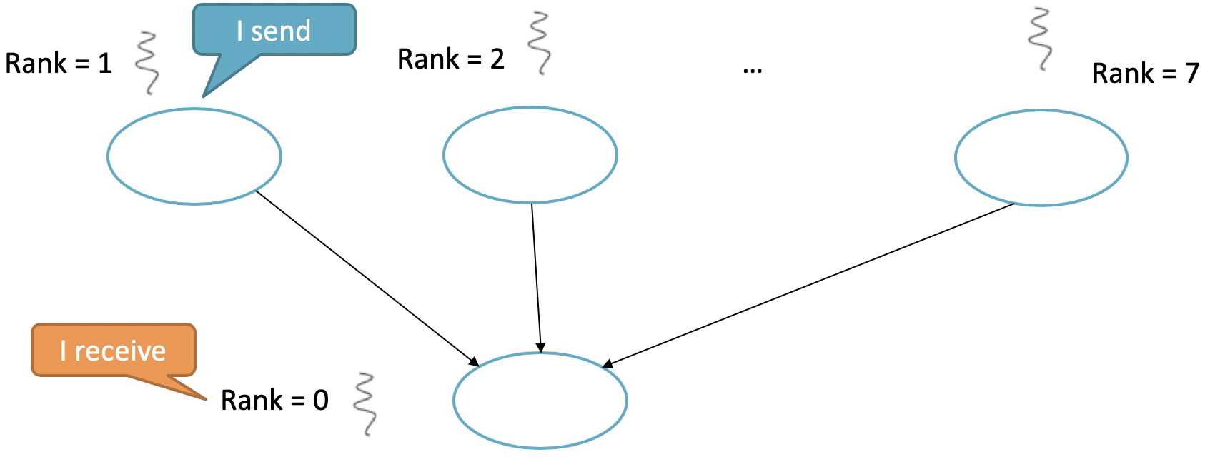
Conclusion
Point-to-Point communication
MPI_Send
MPI_Receive
MPI_Reduce
MPI_Bcast

Slide 47
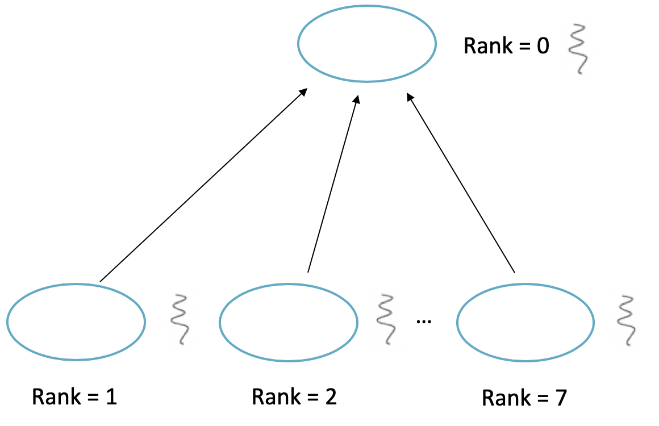
Conclusion
MPI_Scatter
MPI_Gather

Slide 48
What is the Difference between Point-to-Point communication and MPI_Gather?
Point-to-Point communication
MPI_Send
MPI_Receive
Message can be different contents and formats
Message must be same formats
MPI_Gather

Slide 49
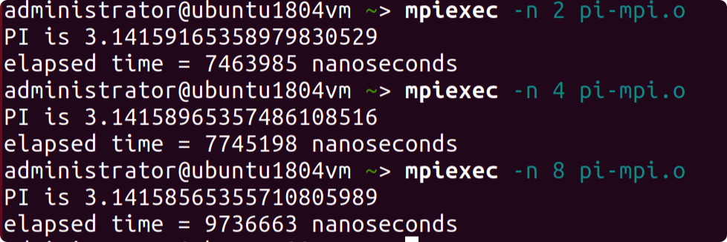



Hint of Project
Result in a.aa:
2 digits
3.332 ≈ 3.33 + 1.999 = 5.329 ≈ 5.33
1.555 + 1.777 + 1.999 = ?
3.776 ≈ 3.78 + 1.555 = 5.335 ≈ 5.34

Slide 50
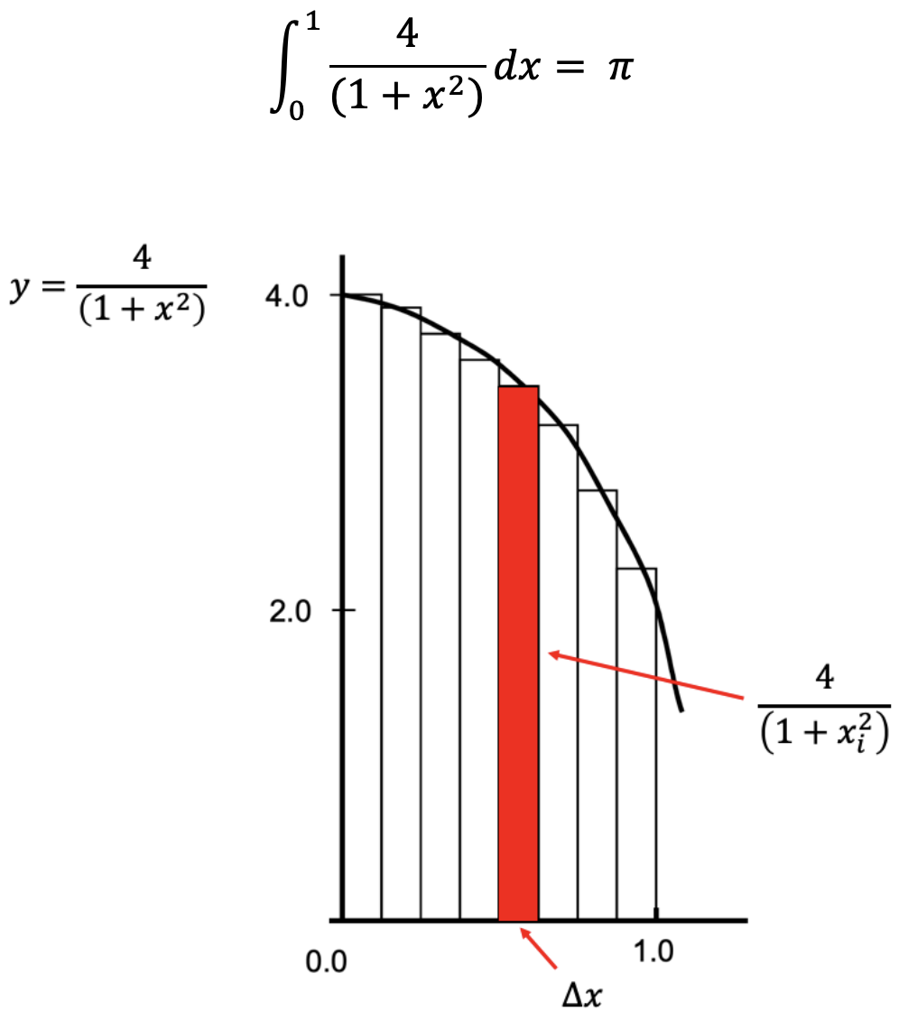

Hint of Project
height=
x_{i}
width=step

Slide 51
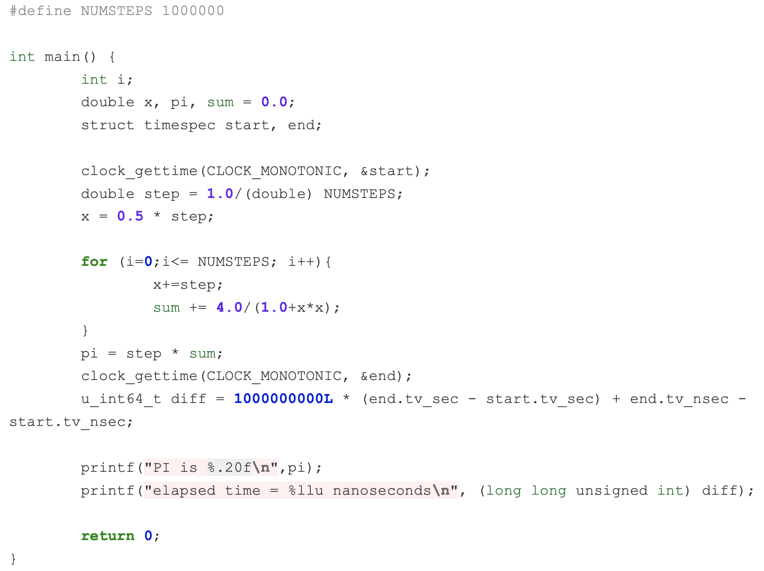
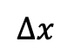
Hint of Project
$$∆x$$
y
size of rectangle

Slide 52
Hint of Project
I send
Rank = 1
Rank = 2
Rank = n
Rank = 0
I receive

Slide 53
Hint of Project
Rank = 1
Rank = 2
Rank = n
Jump over num_procs
rank_ID

Slide 54
Hint of Project
Rank = 1
Rank = 2
Rank = n
Jump over num_procs
rank_ID

Slide 55
Hint of Project
MPI_Bcast: broadcast information to all threads
MPI_Reduce: sum up results together

Slide 56
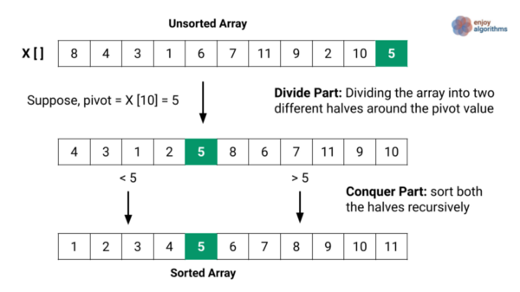
Hint of Project
One thread

Slide 57
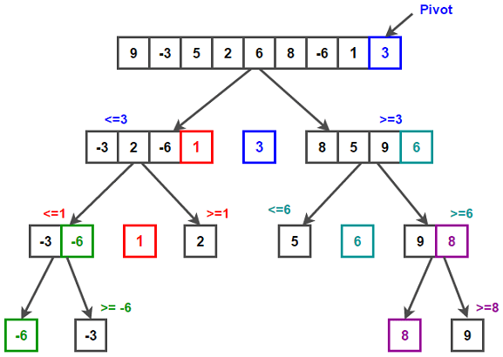
Hint of Project
Four threads

Slide 58
Overview
Hadoop, zookeeper, Kafka, Dapper, MapReduce,
GFS, Comet, Spanner, ...
Distributed coordination
Distributed scheduling
Distributed management
Distributed Computation
Distributed Storage
Distributed Communication
Distributed Resources
resource
management

